Slide 1

Comparing Supervised Machine Learning Algorithms for Breast Cancer Diagnosis
Notes:
Good evening, everybody we are team 3 and our project is titled Comparing Supervised Machine Learning Algorithms for Breast Cancer Diagnosis

Slide 2

Introduction
In 2020, breast cancer caused 2.3 million new cases and 685,000 deaths globally.
By 2040, it's projected to rise to 3 million new cases (40% increase) and 1 million deaths (50% increase).
Machine learning models like logistic regression, random forests, and neural networks enhance diagnosis accuracy and efficiency.
Notes:
Why breast cancer?
Breast cancer stands as the most frequently detected cancer in women. In the year 2020 over 600K lives lost due to this devastating disease.
Machine learning enhances breast cancer diagnosis accuracy and efficiency and can help to effectible predict malignancy in breast cancer.

Slide 3

Overview
This analysis:
Assesses ML algorithm effectiveness based on diverse metrics.
Analyses outcomes using performance metrics and provides answers to our research question.
Which supervised learning algorithm, from those assessed is the most effective in distinguishing malignant from benign breast cancer?
To finish suggesting future research and implications.
Notes:
This analysis:
Will assess the effectiveness of 5 ML algorithms based on diverse metrics.
Analyses outcomes using performance metrics and provides answers to our research question
Which supervised learning algorithm, from those assessed with the Breast Cancer Wisconsin dataset, was most effective in distinguishing malignant from benign breast cancer?
To finish suggesting future research and implications.

Slide 4

Objectives
The study will develop and evaluate multiple machine learning models for diagnosing breast cancer using a publicly available dataset.
Five machine learning models will be compared to identify the one that performs best in predicting breast cancer diagnosis. The models include random forests, decision trees, logistic regression, support vector machines and neural networks.
The study's results could have significant implications for improving the accuracy and efficiency of breast cancer diagnosis, which can lead to better diagnostic outcomes.

Slide 5

Data Set Extraction and Preparation
The data was extracted from Kaggle - UCI Machine Learning
Dataset includes 30 features
Class distribution: 357 benign (B), 212 malignant (M).
We took care to eliminate any unnecessary columns, address possible missing values, and organise the data into structured Data Frames.
Additionally, we encoded the target variable for compatibility with machine learning models, while also ensuring a clear separation between the feature data and the target variable.
Finally, we standardized the feature data to ensure consistency and optimal model performance.

Slide 6
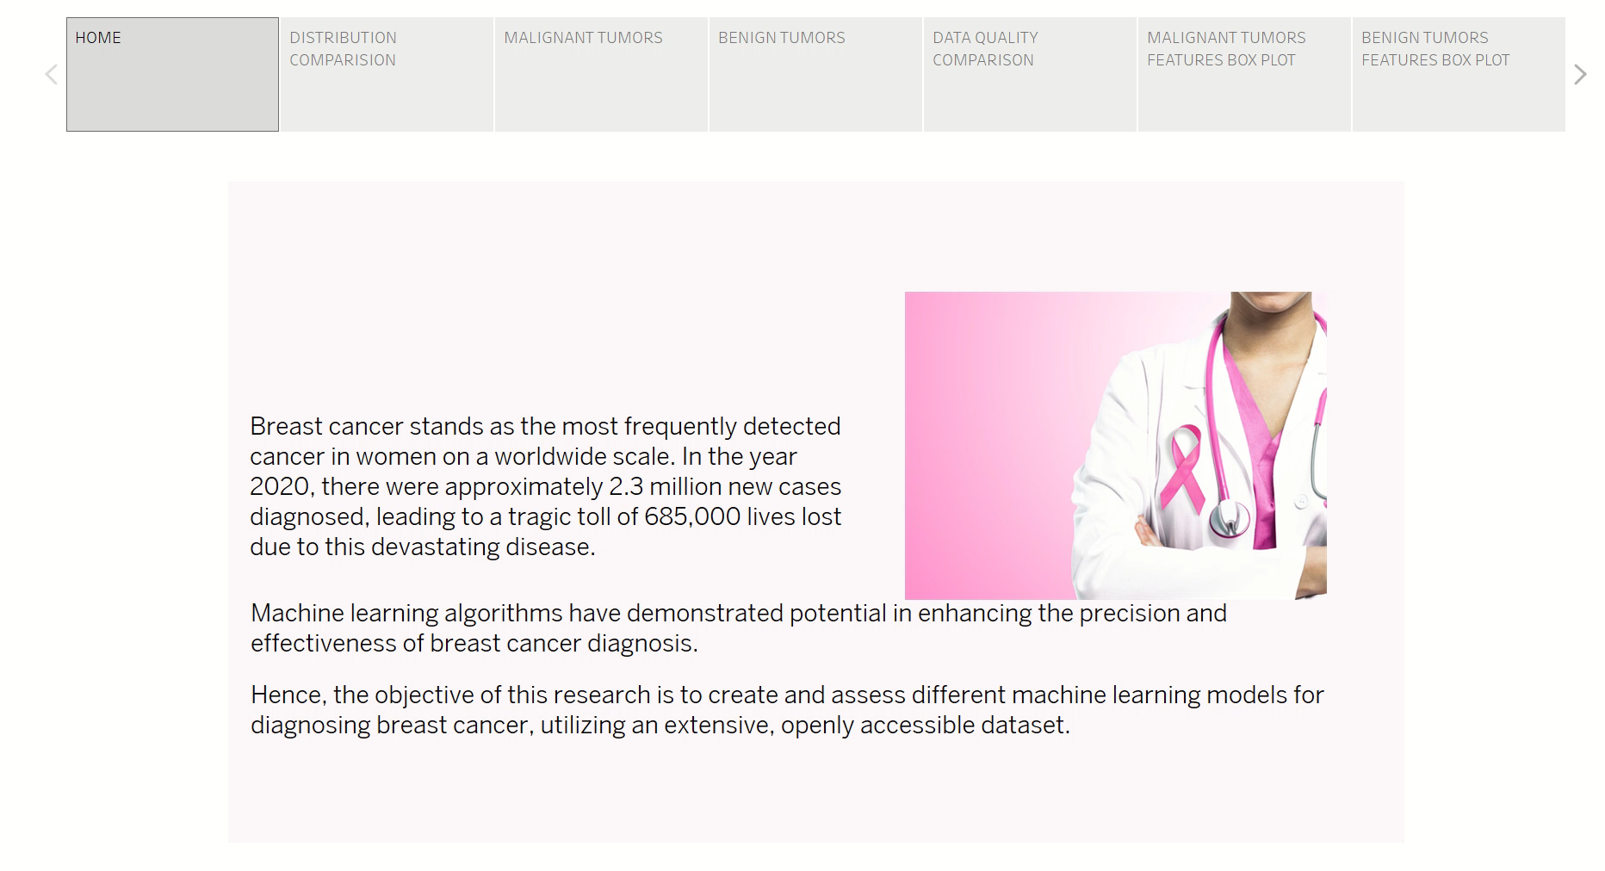
Dataset Overview

Slide 7
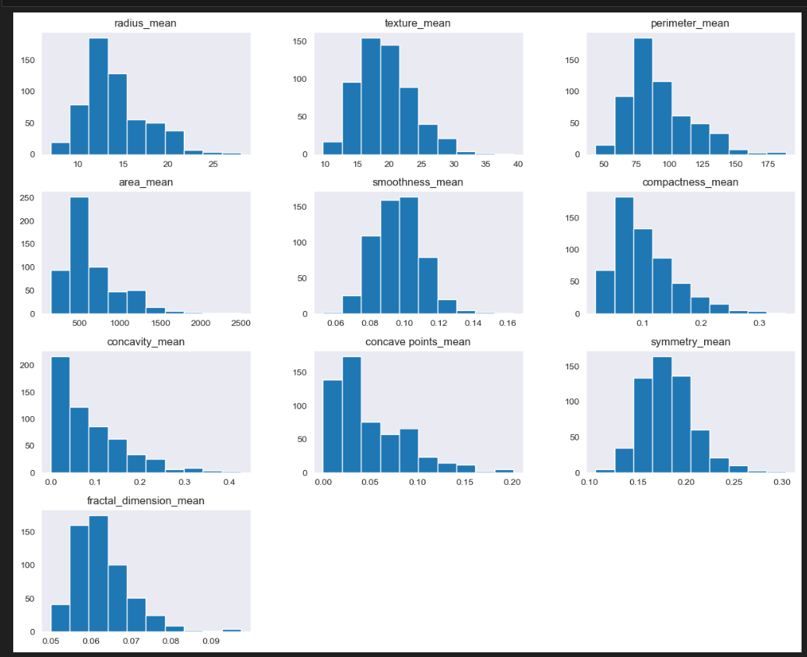
HISTOGRAM PLOTS

Slide 8
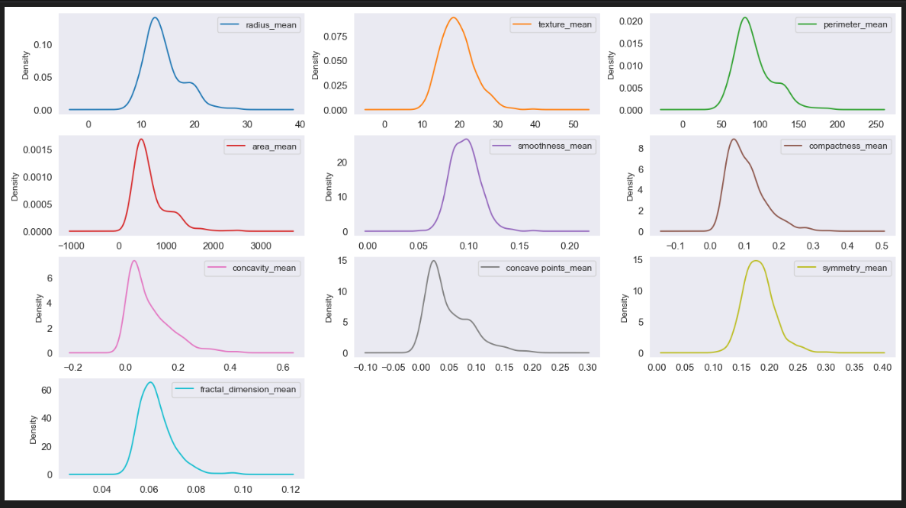
DENSITY PLOTS

Slide 9
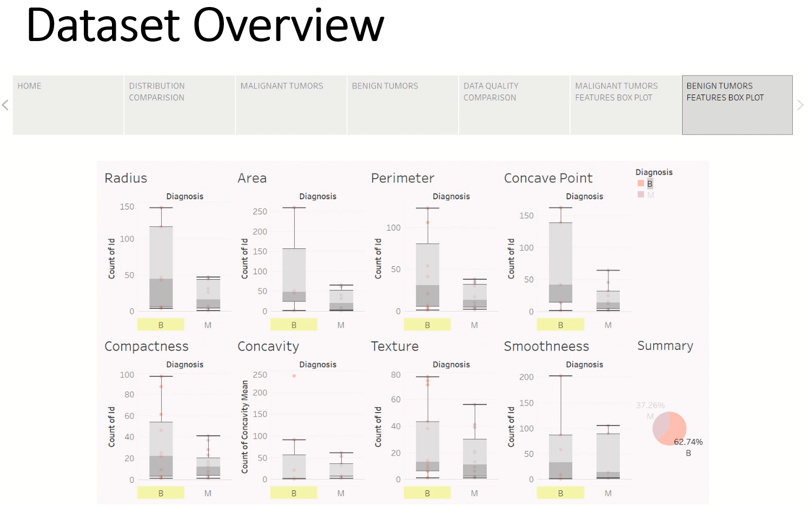

Slide 10
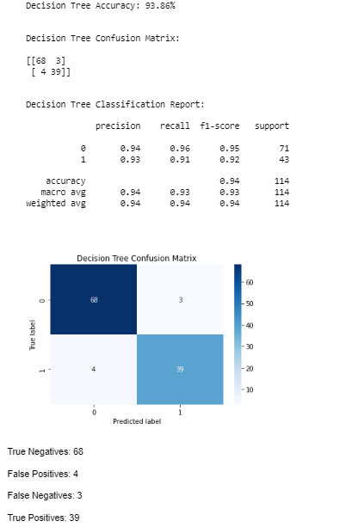
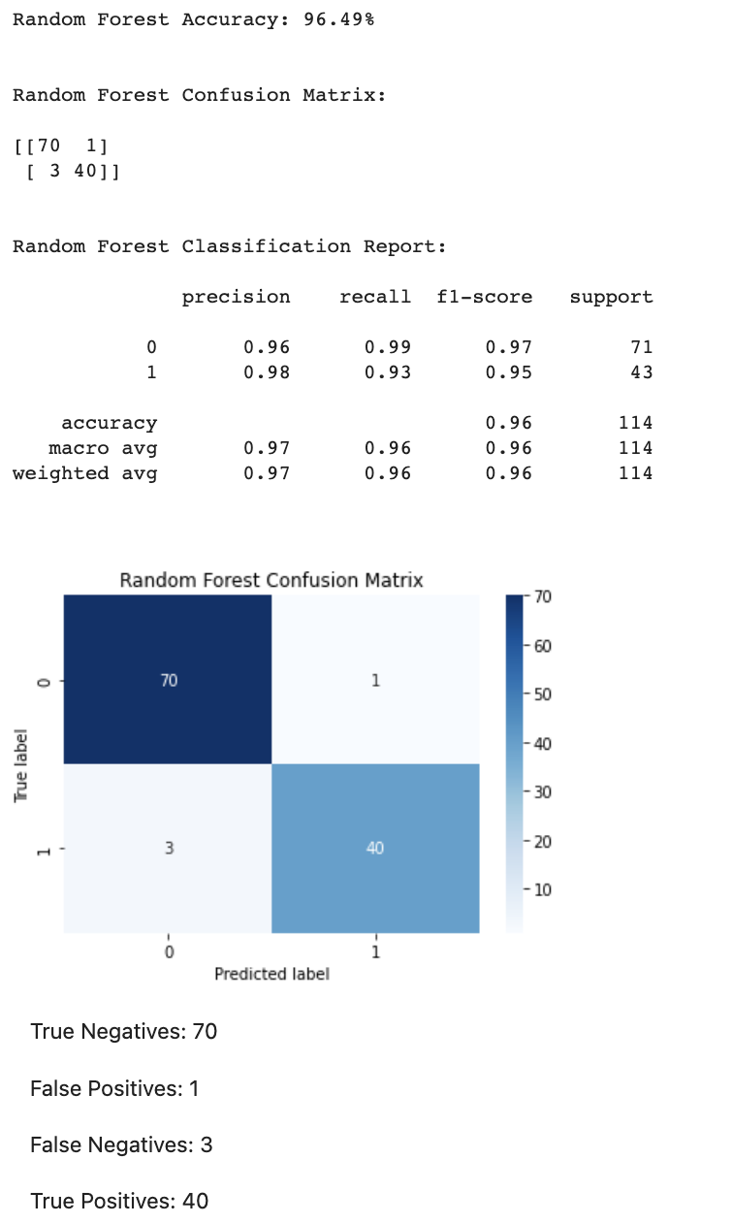
Decision Tree vs Random Forest Model
The random forest model had better outcomes compared to the decision tree model. The decision model gets more false negatives. Four cells have been identified as benign when they are malignant. Whereas the Random Forest had only 1 false negative result.

Slide 11
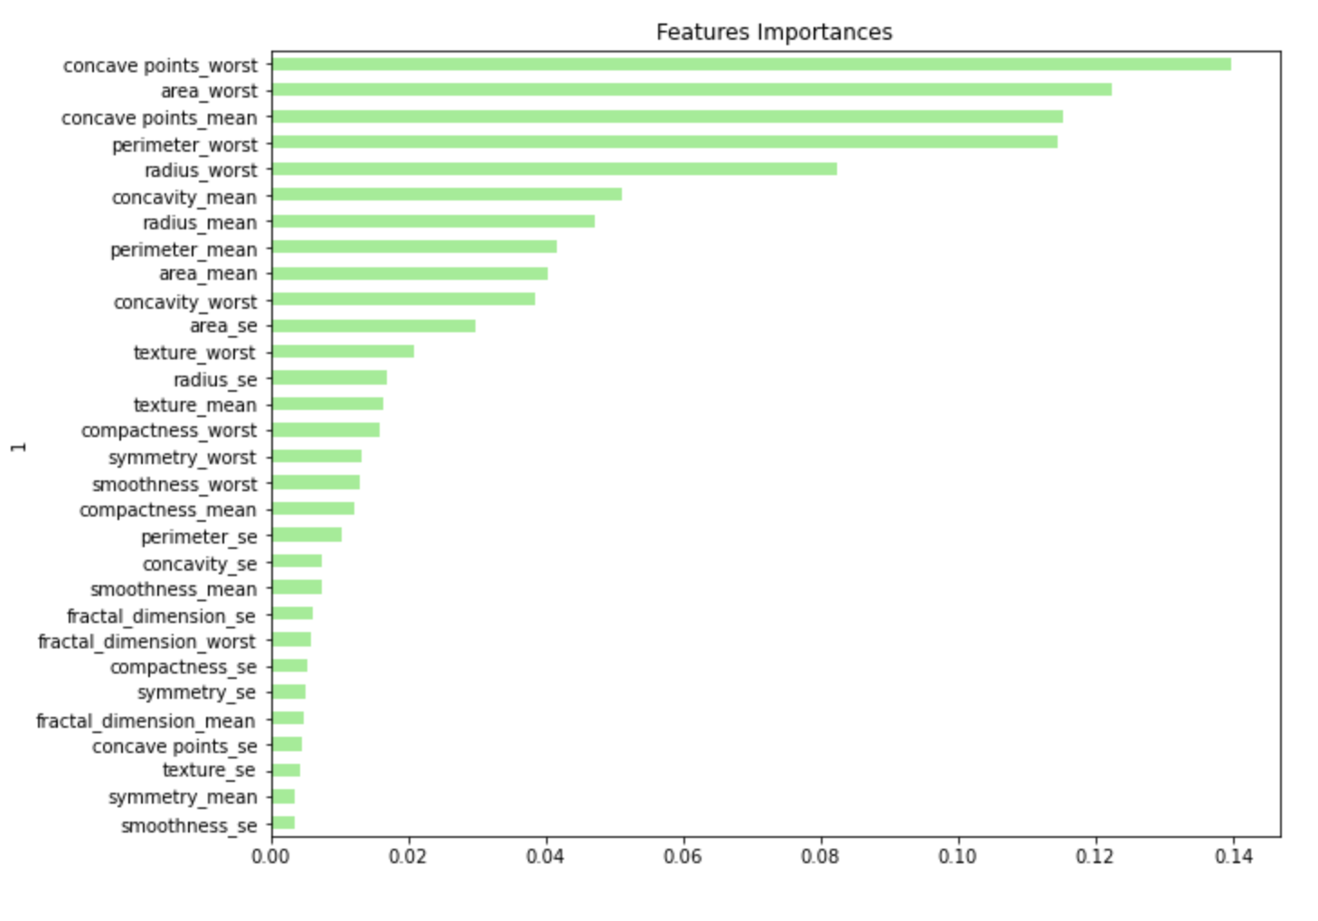
Decision Tree vs Random Forest Model
Random Forest models tend to get better results than a single Decision Tree model for classification problems for several reasons:
Ensemble Learning: Random Forest is an ensemble learning method, which means it combines the predictions of multiple individual decision trees to make a final prediction.
Reduced Overfitting: Decision Trees are prone to overfitting. Random Forest mitigates this issue by averaging the predictions of multiple trees, effectively reducing overfitting.
Feature Randomization: The Random Forest introduces an element of randomness by considering a random subset of features for each tree.
Better Handling of Outliers: Decision Trees can be sensitive to outliers, as they can create deep branches that focus on specific data points. Random Forest, by combining the results of many trees, is more robust to outliers.
Overall, Random Forest is a powerful machine-learning technique that leverages the strengths of Decision Trees while addressing their limitations
Notes:
Our second machine-learning model was the random forest.
This Gave a higher accuracy 96.49% The ensemble nature of Random Forest often leads to improved accuracy, making it one of the go-to methods for many classification problems.
The precision score for identifying malignant cells was 98% compared to 91%in the decision tree model
Automatic Feature Importance: Random Forest can provide feature importance scores, indicating which features are most relevant for the classification task. This information can be valuable for feature selection and understanding the underlying patterns in the data.
We sorted the features by the importance which can be seen – concave point worst was the most influential feature.

Slide 12
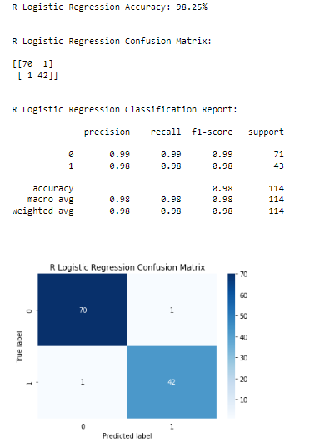
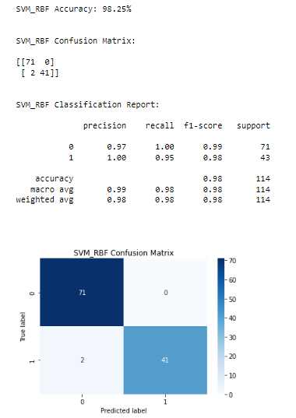
Analysis
Logistic Regression
Support Vector Machine (SVM)
Why did logistic regression and SVM yield similar results?
Both models work well with Binary classification focus problems.
Optimizing decision boundaries.
Similar Regularization techniques to avoid overfitting.
Similar assumptions about data distribution
Notes:
Another two models examined were logistic regression and support vector machine which showed to performed very similar, some of the reasons are
Both models work well with Binary classification focus problems.
Optimizing decision boundaries.
Similar Regularization techniques to avoid overfitting.
Similar assumptions about data distribution

Slide 13
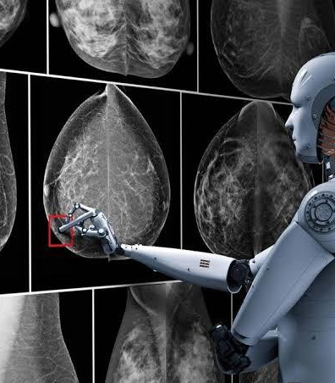
Analysis
Which Metric is more important?
Accuracy: overall correctness of predictions
Recall: minimize false negatives (malignant as benign)
Precision: minimize false positives (benign as malignant)
F1 score: balanced measure of precision & recall
Importance: high precision & recall for patient outcomes
Notes:
But when evaluating what was important for the kind of problem, we were attacking, we realised that precision which minimise false positives and even more important recall, which minimized false negatives, were the metrics to prioritize because of the outcome to patients.

Slide 14
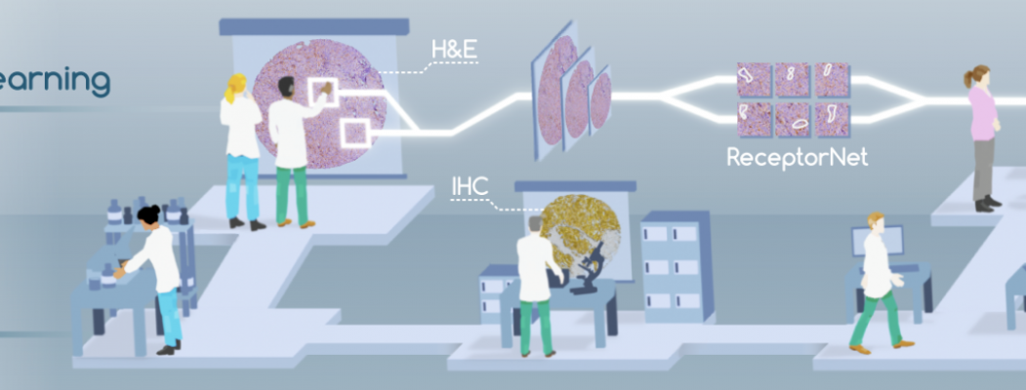
Optimization
Neural Network Optimization:
Scaling the Dataset
Adding two additional layer
Increasing the number of nodes in the first two layers.
Changing the activation function from ReLU to Sigmoid.
Increasing the number of Epochs
Classification reports are calculated based on the confusion matrix to provide a comprehensive summary of the model’s performance in terms of various evaluation metrics such as accuracy, precision, recall, and F1 score
Notes:
Neural networks showed to overall have a better recall from early stages of the analysis so it was our go to work further and optimize as much as we could.
For our final and overall best performing model, we:
Scaled the Dataset
Added two additional layer
Increased the number of nodes in the first two layers.
Changed the activation function from ReLU to Sigmoid. And
Increased the number of Epochs

Slide 15
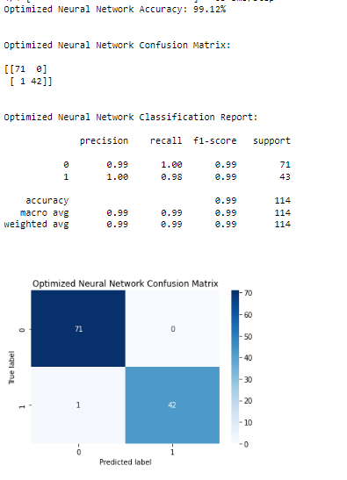


Optimized Neural Network
The implemented key optimizations in the neural network original model, led to a substantial performance boost.
These adjustments collectively contributed to achieving the best performance among all the models tested, showcasing the significant impact of these enhancements on the model's effectiveness.
Notes:
To ended up with 98.84% recall and 99.31% precision.

Slide 16
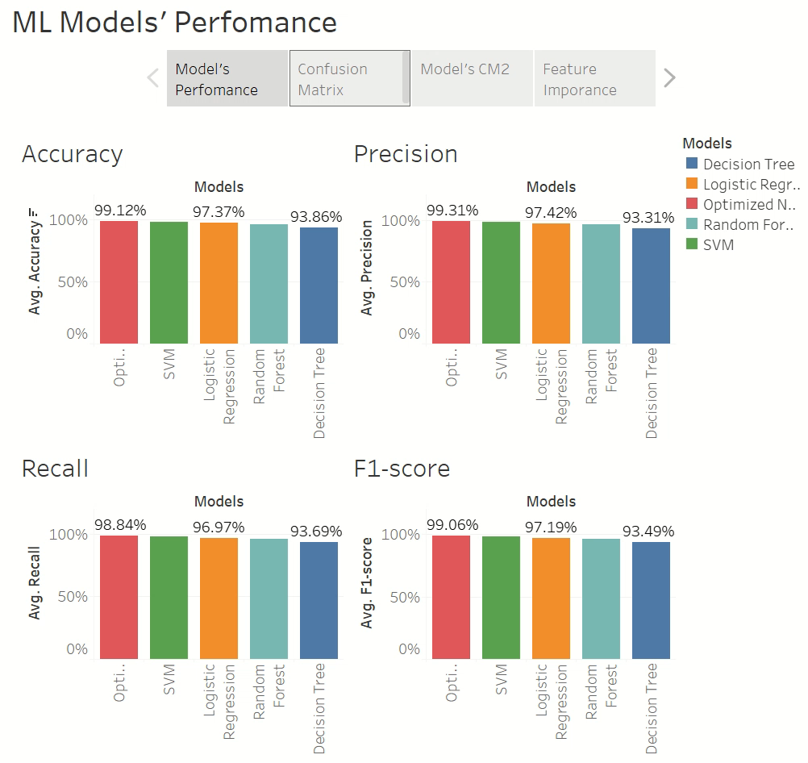
Model Performance Metrics Comparison

Slide 17
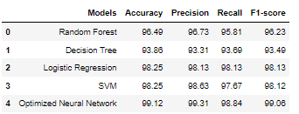
Conclusion
Given the described training/testing data set:
Optimized Neural Network
Highest Accuracy (99.12%)
Top precision (99.31%)
Top F1-score (99.06%)
Top recall (98.84%)
The Optimized Neural Network emerged as the top performer overall, although the variations in performance among the models were relatively minor,

Slide 18
Recommendations
Deploy The Optimized Neural Network model for this use case: High accuracy, precision, recall, and F1-score
Consider problem requirements for future use cases and emergence of new training data sets
Some algorithms may not scale well for large datasets, or non-linear data
Factors that affect future model selection:
Computational resources
Interpretability
Data set size

